Slide 1
Module 1
Introduction to Databases

Slide 2
Chapter 2:
Overview of Database Languages and Architectures

Slide 3
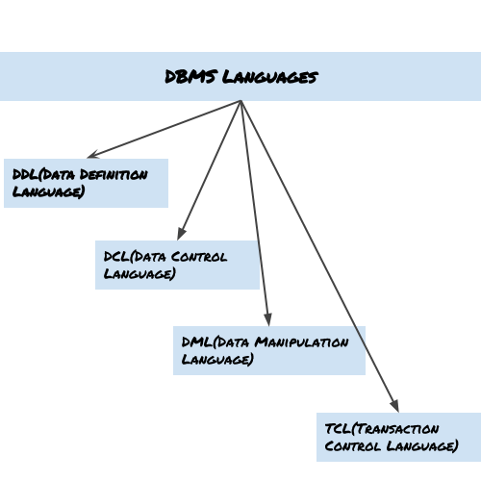
Database Languages

Slide 4
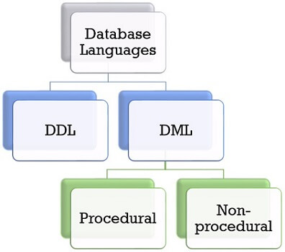
Database Languages

Slide 5
Data Model
Data modeling in DBMS is the process of representing data in a database management system (DBMS).
It helps to organize data, identify relationships, and ensure data security.
It is a framework that defines how data is organized and connected.
Its like architecture of a building that ensures data is organized.
A data model is a collection of concepts that can be used to describe the structure of a database.
By structure of a database, we mean the data types, relationships and constraints that apply to the data.

Slide 6
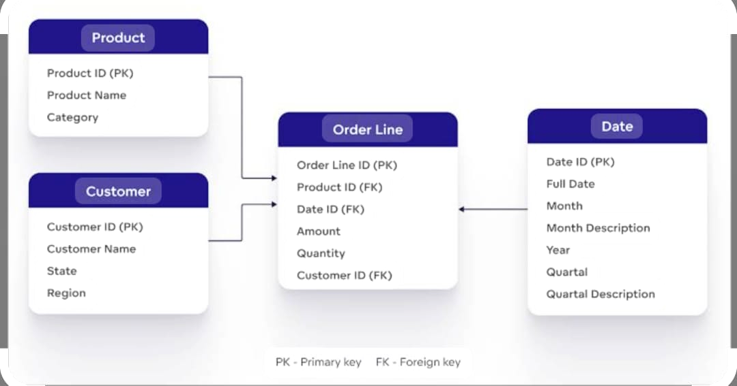

Slide 7
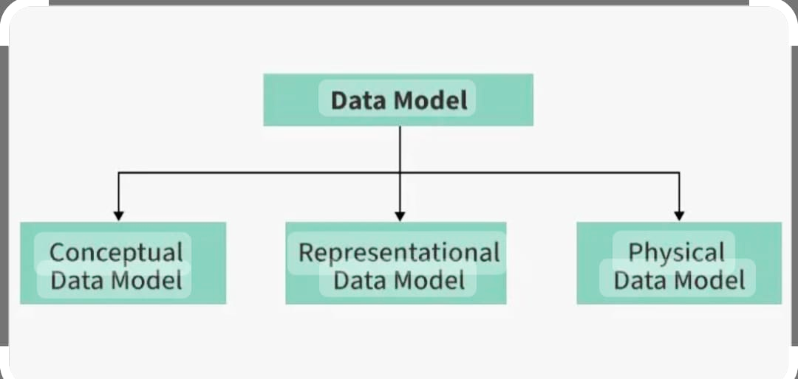

Slide 8
Conceptual Data Model: To represent the high-level structure of the data without worrying about how it will be physically implemented.
It focuses on what data is important and the relationships between different data entities.
Representational Data Model (Logical Data Model): It serves as a bridge between the conceptual model and the physical model, providing a more detailed structure of the data.
It outlines how data will be represented and organized in the database without specifying physical storage details.
Physical data Model: This model describes how the data will be physically stored in the database. It is concerned with performance, optimization, and efficient storage, considering the specific database system and hardware in use.

Slide 9
Categories of Data Models
High-level or conceptual data models: The Conceptual data model describes the database at a very high level and is useful to understand the needs or requirements of the database.
It is used in the requirement gathering process.
Before the database designer starts making a particular database, Conceptual data models use concepts such as entities, attributes, and relationships.

Slide 10
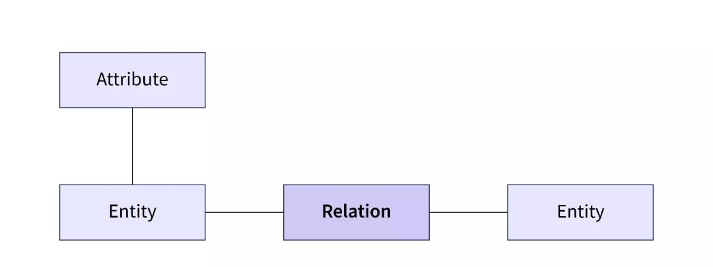
A Data Entity is a structured framework designed to simplify access and management of data within an application or across multiple systems
A Data Entity is referred as a real-world object .
This are represented by a
rectangle in ER Diagram

Slide 11
Relationship are used to define relation among different entities.
Relationships help organize entities and work with data.
For example, in a university database, relationships could connect students to courses they can take.
Attributes can be defined as the description of an entity
Attributes are the characteristics that define entities.
If studentname is an entity, USN is an attribute

Slide 12
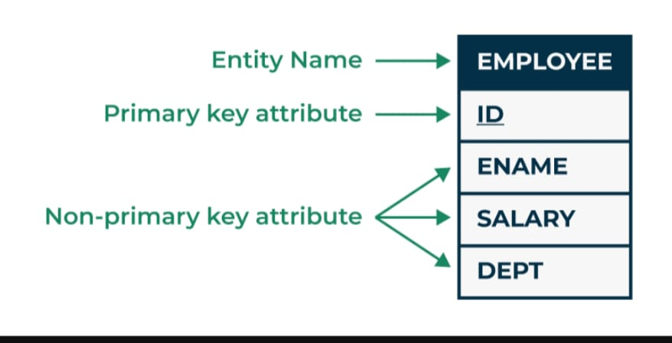

Slide 13
2. Representational or implementation data models:
Representational data model is used to represent only the logical part of the data model and does not represent the physical structure of the database.
3. Low-level or physical data models:
provide concepts that describe the details of how data is stored on the computer storage media, typically magnetic disks.
Physical data models describe how data is stored as files in the computer by representing information such as record formats, record orderings, and access paths.
(Physical storage: A 500GB hard drive with specific sectors where data is physically stored. Logical storage: A "Documents" folder on your computer which appears as a single location to the user, even though the data is spread across different physical sectors on the hard drive.)

Slide 14
Database schema
The description of a database is called the database schema, which is specified during database design and is not expected to change frequently.
An "entity" represents a real-world object or concept, like a customer or product, while a "schema" defines the overall structure of the database, including the tables, columns, data types, and relationships between entities, essentially acting as a blueprint for how data is organized within the database; an entity is a single building block within the schema.
It is known as blueprint with the help of which we can explain that how data is organized into tables.
The data in the database is called instances.

Slide 15
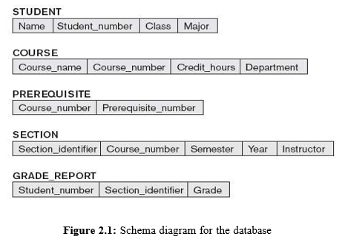
Schema diagram
A displayed schema is called a schema diagram. A schema diagram displays only some aspects of a schema, such as the names of record types and data items, and some types of constraints.

Slide 16
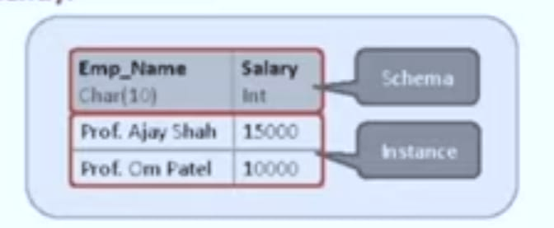
Instance
The collection of information stored in the database at particular moment is called Instance.
Instances are changed frequently.
Schema
The overall design of database is called database Schema.
Schemas are changed rarely.

Slide 17
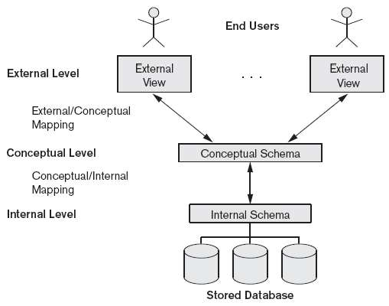
The Three-Schema Architecture
Goal: To separate the user applications and the physical database.

Slide 18
3 Level:
The external or view level includes several external schemas or user views describes the part of the database that a particular user group is interested in and hides the rest of the database from that user group.
The conceptual level has a conceptual schema that hides the details of physical storage structures and concentrates on describing entities, data types, relationships, user operations, and constraints.
The internal level has an internal schema that describes the physical storage of the database. Describes the complete details of data storage and access paths.

Slide 19
Data Independence
The ability to change the schema at one level without changing the schema at another level.
It refers that changes made in any level of database should not affect to its next high level.
There are two types:
1) Physical data independence:
Physical data independence is the capacity to change the internal schema without having to change the conceptual schema. Hence, the external schemas need not be changed as well.
2) Logical data Independence:
Logical data independence is the capacity to change the conceptual schema without having to change external schemas or application programs.

Slide 20
Database Languages or DBMS languages
In order to perform operation on the database like CREATE, SELECT, INSERT, DELETE, UPDATE , database language is use.
To perform Operations on database, SQL COMMENTS are use.
Types of database language
Data Definition language(DDL) :It contain commends which are required to define the database.
Defines database schema.(define conceptual Schema)
Define logical structure of database.
Ex: CREATE, ALTER, DROP, TRUNCATE.

Slide 21
2) Data Manipulation Language: It contains commands which are required to manipulate the data present in the database. Ex: SELECT, UPDATE, INSERT, DELETE.
Allow user to perform operation such as insertion, deletion, modification and retrieval.
3) Storage Definition Language: Is used to specify the internal storage Schema (Physical Storage)
4) View Definition Language: Specifies user views/ mapping to conceptual schema
5) Data Control Language: It contains command which are required to deal with user permission and control the database system. Ex: Grant, Revoke
6) Transaction Control Language: It contain commands which are required to deal with transaction of database. Ex: Commit, Rollback.

Slide 22
CREATE DATABASE-Create a new database.
CREATE TABLE-Create a new table.
ALTER TABLE-used to add, delete or modify columns in an existing table.
Alter command will perform the action on structure level and not on the data level.
SELECT-Extract the data from database.
UPDATE-update data in database.
The UPDATE statement is used to modify the existing records in a table.
INSERT- Inserts new data into the database
GRANT command is used to give access to users.
REVOKE withdraws the access.
ROLLBACK-used to undo those transactions that aren’t saved yet in the databased.
(Transaction in DBMS is a series of tasks that are treated as a single unit of work)

Slide 23
DBMS Interfaces
An interface is a program that allows users to query the DBMS without writing the code in the query language.
An interface can be used to manipulate the database, either for adding data or deleting some data, updating data or even for viewing the data present in the database.

Slide 24
Form-based Interface
Form-based interface displays a form to each user.
The user enters all the details and submits the form to create a new entry in the database.
Or the user fills out some details, and then the system retrieves rest of the details from the database.
Form-based interfaces are built for Naïve users who have to do only a limited number of operations.
Example
A form-based interface is a teacher adding students’ attendance to the system.
Student enters his or her roll number, class and branch in a form to retrieve his or her exam results.

Slide 25
Menu based user interface
These interfaces present the user with lists of options (called menus) that lead the user through the formulation of a request.
In Menus, the user don't need to memorize the specific commands and syntax of a query language; rather, the query is composed step-by step by picking options from a menu that is displayed by the system.
Pull-down menus interfaces are mostly used in Web-based user interfaces.
Example
Lets say you are searching for some item on a shopping website.
First thing you do is go the categories menu and select the category in which the item falls
.Then you select the brand from the menu of brands.
Then you search through different models of that item in the menu.
Then you might select the budget you have from the menu of budget range.

Slide 26
Graphical user interface
A GUI typically displays a schema to the user in diagrammatic form.
The user then can specify a query by manipulating the diagram.
In many cases, GUIs utilize both menus and forms.
Most GUIs use a pointing device, such as a mouse, to select certain parts of the displayed schema diagram
Example of a GUI
Let's say you are watching this video on YouTube.
If you press that subscribe button, either with a finger or a mouse, it will turn grey.
There are forms used in YouTube, too, as you search for a topic on YouTube.
There are Menus also used on YouTube, as YouTube shows you different videos on different channels, and it gives you a menu to select videos of a certain length or from a certain time.
And all this interface is visually graphics and changes according to the action the user takes.
Hence, Graphical User Interface.

Slide 27
Natural Language Interface
Natural language interface has its own high-level, unique schema, more like the high-level conceptual schema.
It also has its own dictionary of important words.
Basically, it generates a query based on the interpretation of important words in the input by the user, and if the interpretation is successful, then it displays the result to the user.
Example
Let’s say, you want to find out which is the fastest car in India, so you search for fastest car in India on a search engine like Google, which is a natural language interface.
The Natural language interface then looks at the important words in the input by the user: Fastest, car, India.
Now it will go into the database of cars and search for all the cars that are available in India. Then it will check the car with the highest speed among the cars available in India.
And finally, it will show the outcome of the search to the user.

Slide 28
Speech Input and output
Nowadays it has become a common type of interface.
The users queries the interface with speech, and gets an answer or response in speech if the interface understands the query and interpret it.
Example
Most of you must have used either Siri on apple, or OK google, or Alexa or Cortana to ask some questions like,
"OK, google, find the value of square root of 729“
"Or Alexa, what is the capital of Nepal“
And these speech user interfaces interpret your speech input and processes the data from the database and after successful interpretation answers you back in speech.
If the query is not understood, it will ask you to repeat the query.

Slide 29
Interface for Parametric users
Parametric users are users who have a small set of operations that need to be performed and that too repeatedly.
This makes it important to reduce the number of keystrokes for each operation.
So the programmers program such interface so that the operations can be performed with single key stroke.
Example
Let's say there is an ATM. The ATM has limited operations to do like, check the balance, withdraw money or change pin of the card.
So as you know, any of these operations which are complex programmatically but the queries are generated with minimal key strokes, as there are only three operations the ATM has to perform and nothing more.

Slide 30
Interface for DBA
Most database systems contain privileged commands that can be used only by the DBA staff.
These include commands for creating accounts, setting system parameters, granting account authorization, changing a schema, and reorganizing the storage structures of a database

Slide 31
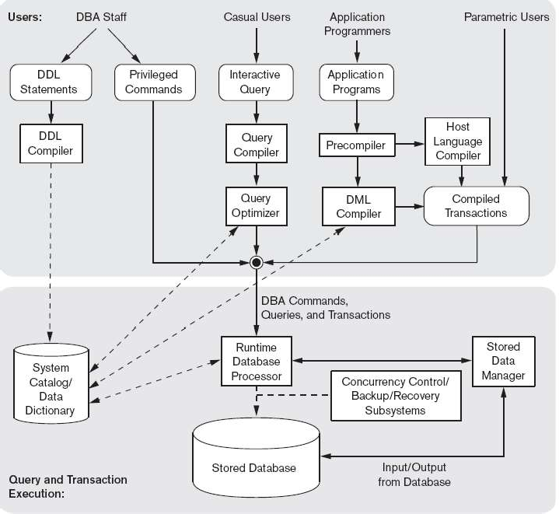
  The Database System Environment
  DBMS Component Modules

Slide 32
This Diagram shows the different component has to be defined by database administrator and the database designer.
The top part of the figure refers to the various users of the database environment and their interfaces. The lower part shows the internals of the DBMS responsible for storage of data and processing of transactions.
Once the database Design is completed the schemas has to be defined by the database administrator and the database designer.
So that DBA and its staff uses data definition language or DDL to specify these schemas.

Slide 33
DDL compiler processes schema definitions that is specified in the DDL and stores descriptions of the schemas (meta-data) in the DBMS catalogue.
Interactive query interface: an interface for Casual users and persons with occasional need for information from the database.
Query compiler- validates for correctness of the query syntax, the names of files and data elements & compiles them into an internal form.
  Query optimiser- concerned with the rearrangement and possible reordering of operations, elimination of redundancies and use of correct algorithms and indexes during execution.

Slide 34
Pre-compiler - extracts DML commands from an application program and sends them to the DML compiler for compilation into object code for database access.
Host language compiler – the rest of the program is sent to the host language compiler.
The object code and the remaining program are linked together to form the canned transaction
Runtime database processor executes the privileged commands, the executable query plans, and the canned transactions with runtime parameters.

Slide 35
END of Module 1

